Slide 1
Empirical Analysis of External Travel and State Highway 130 in Austin, Tx Using Cellular Data
L.D. White
Texas A&M Transportation Institute
Byron Chigoy
Texas A&M Transportation Institute

Slide 2
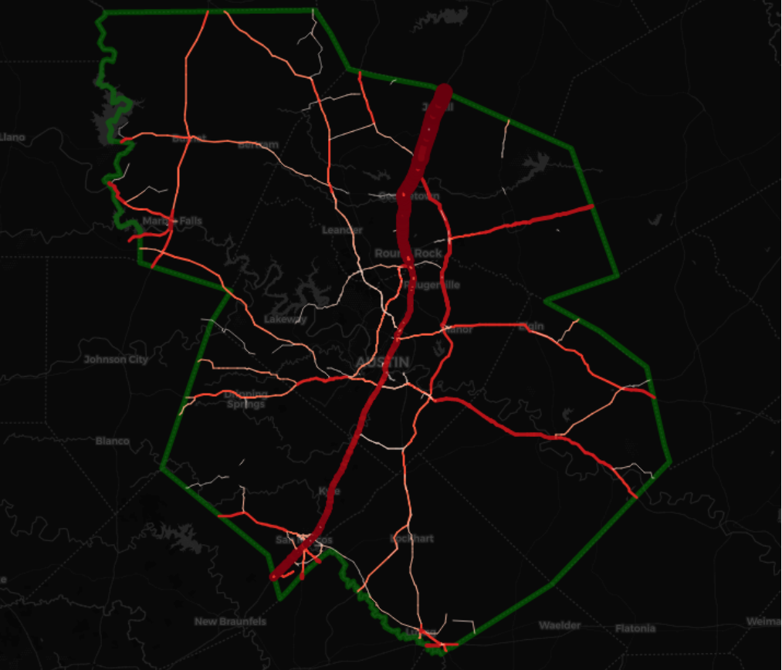
Part of external travel study for Austin, Tx
Cellular-based external trips in zone-to-zone O-D matrix
Select-link analysis used to assign external trips to the roadway network
TDM Link Flows

Slide 3
Three network speed reduction scenarios were used to explore the role SH 130 plays in external travel in, out of, and through the region:
10% reduction
20% reduction
30% reduction
TDM Link Flows

